Slide 1
Lab 7 and 8: Characteristics of BJT and Amplification Behavior
EE316-08 Spring 2021

Slide 2
Purpose: The concept and characteristics of bipolar junction transistors (BJTs) is introduced. The basic concepts investigated for BJTs carries over into future labs, especially for MOSFETs. Both NPN and PNP constructions will be considered. Constants and variables relating to BJTs will be discussed and utilized in the procedure section.

Slide 3
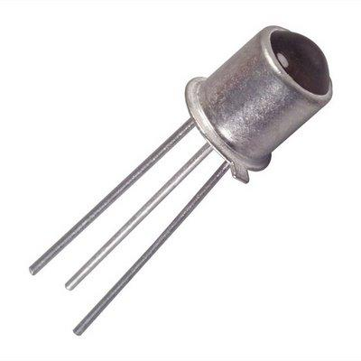
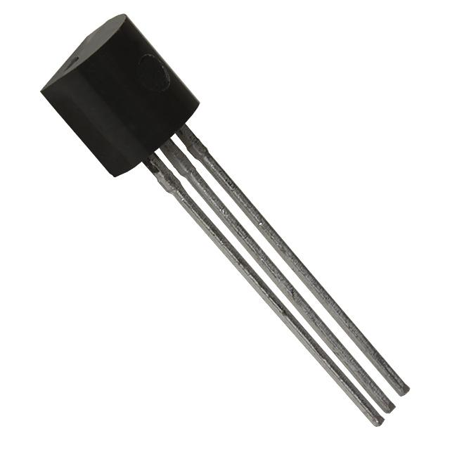


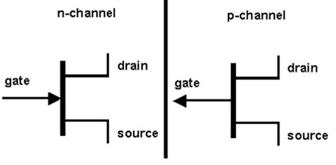
Transistors Background
Transistor is a semiconductor device used as amplifier control or electrically controlled switch.
Transistors can be found in switching circuits, amplifier circuits, voltage-regulator circuits, etc.
Two basic types of transistors are bipolar junction transistors (BJTs) and field-effect transistors (FETs).
The main difference between BJTs and FETs is that BJTs are current-controlled while FETs are voltage-controlled.
Physical and symbolic representation of BJTs
Symbolic representation of FETs

Slide 4
Bipolar Junction Transistors (BJTs)
BJT is the oldest and the most basic transistor.
It is a solid-state current-controlled device used to electronically switch a circuit.
BJT is a three-terminal device with emitter (E), base (B), and collector (C).
The current applied to the base (B) controls the current flow through the emitter (E) and collector (C).
NPN
PNP
Symbolic representation of BJTs

Slide 5
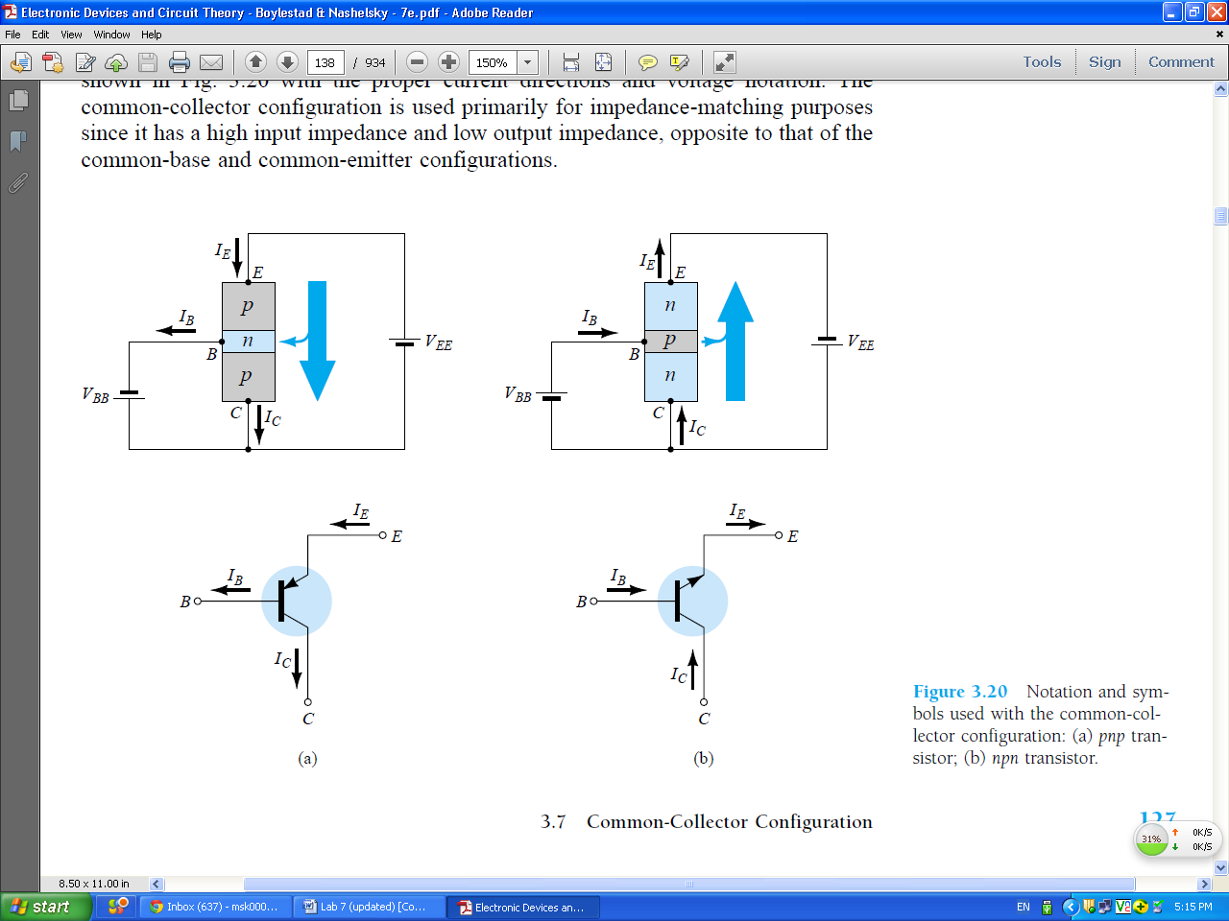
Physical Representation of BJTs
PNP
NPN
Current
Current

Slide 6
Bipolar Junction Transistors (BJTs)
BJT is formed by three layers of semiconductor materials.
PNP transistor has two P-type regions and one N-type region.
NPN transistor has two N-type regions and one P-type region.
PNP
NPN
Current
Current

Slide 7
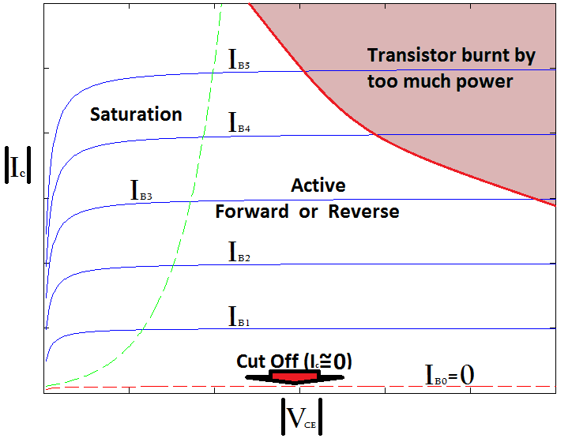
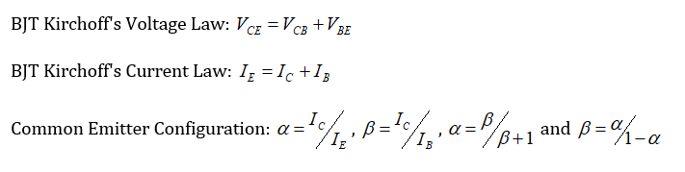
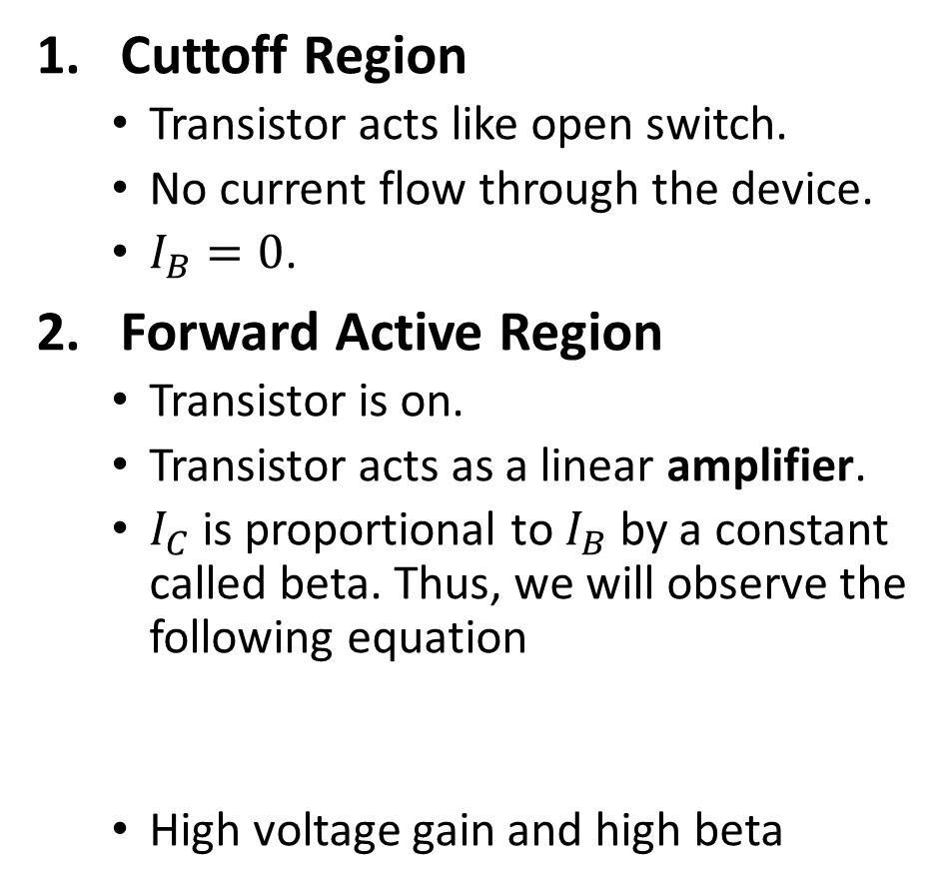
Characteristics of each region of operation
Cuttoff Region
Transistor acts like open switch.
No current flow through the device.
$I_{B}=0$.
Forward Active Region
Transistor is on.
Transistor acts as a linear amplifier.
$I_{C}$is proportional to $I_{B}$by a constant called beta. Thus, we will observe the following equation
High voltage gain and high beta
4.
3.
2.
1.

Slide 8
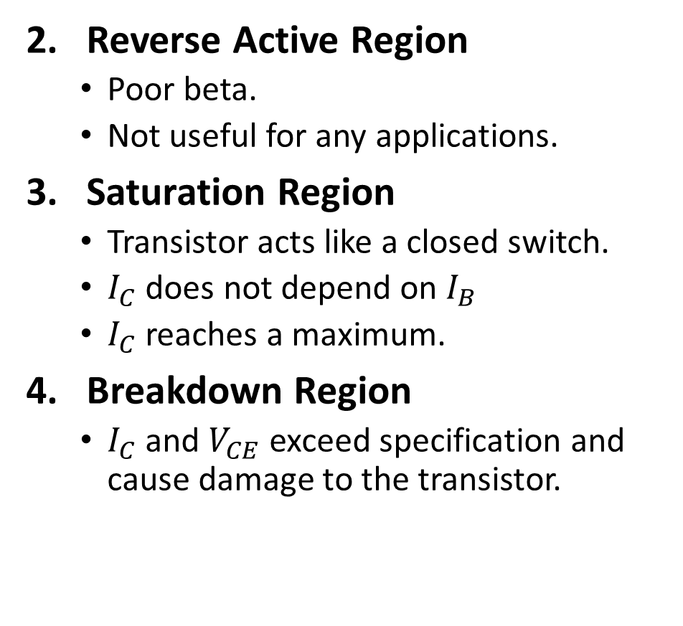
Characteristics of each region of operation
Reverse Active Region
Poor beta.
Not useful for any applications.
Saturation Region
Transistor acts like a closed switch.
$I_{C}$ does not depend on $I_{B}$
$I_{C}$ reaches a maximum.
Breakdown Region
$I_{C}$and $V_{CE}$ exceed specification and cause damage to the transistor.
4.
3.
2.
1.

Slide 9

Useful Equations
PNP
NPN

Slide 10
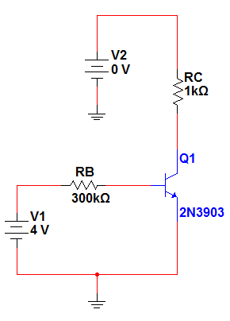






Figure 7.3
$$I_{C}$$
V1 = 10 V
$$V_{C}$$
Collector
$$I_{B}$$
Base
$$V_{B}$$
V1 = 4 V
Emitter
$$V_{E}$$
$$I_{E}$$

Slide 11
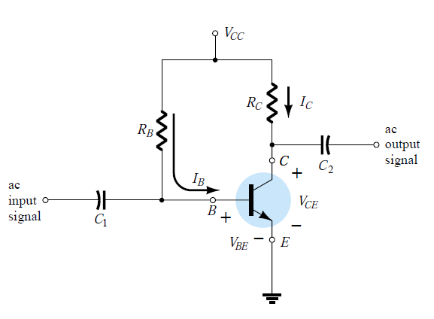
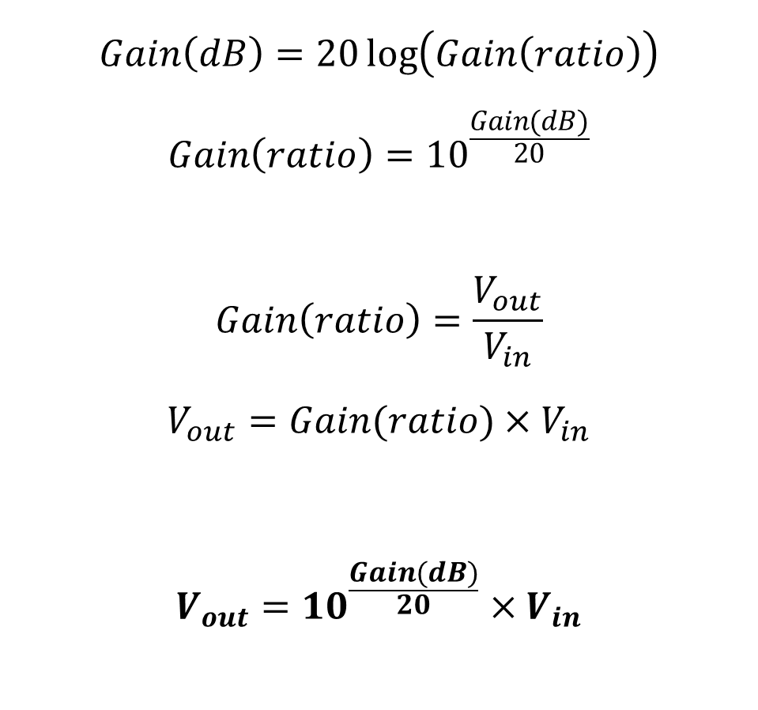
Figure 8.1: Find Vout
$$Gain\left(dB\right)=20\log\left(Gain\left(ratio\right)\right)$$
$$Gain\left(ratio\right)={10}^{\frac{Gain(dB)}{20}}$$
$$Gain\left(ratio\right)=\frac{V_{out}}{V_{in}}$$
$$V_{out}=Gain(ratio)×V_{in}$$
$$V_{out}={10}^{\frac{Gain(dB)}{20}}×V_{in}$$
Don’t forget Vcc

Slide 12

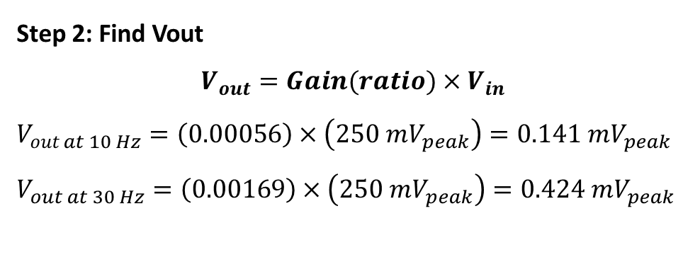
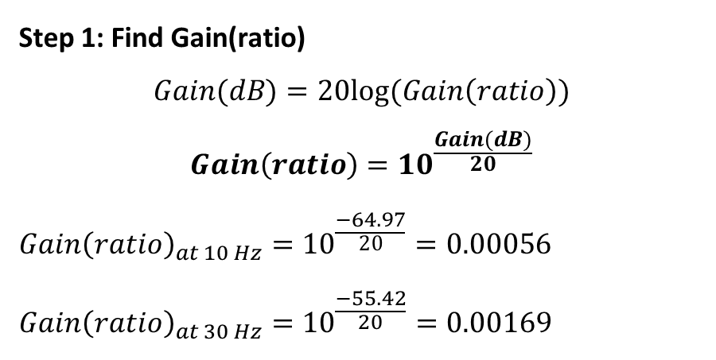
Table 8.1: Example
Given $V_{in}=500mV_{peak to peak}=250mV_{peak}$
Frequency (Hz) | Calculated Vout (mVpeak) | Gain (ratio) | Gain (dB) | Simulated Vout (mVpeak)
10 | 0.141 | 0.00056 | -64.97 | 0.138
30 | 0.424 | 0.00169 | -55.42 | 0.420
Step 1: Find Gain(ratio)
$$Gain(dB)=20log(Gain\left(ratio\right))$$
$$Gain\left(ratio\right)={10}^{\frac{Gain(dB)}{20}}$$
$${Gain\left(ratio\right)}_{at 10 Hz}={10}^{\frac{−64.97}{20}}=0.00056$$
$${Gain\left(ratio\right)}_{at 30 Hz}={10}^{\frac{−55.42}{20}}=0.00169$$
Step 2: Find Vout
$$V_{out}=Gain(ratio)×V_{in}$$
$$V_{out at 10 Hz}=\left(0.00056\right)×\left(250 mV_{peak}\right)=0.141 mV_{peak}$$
$$V_{out at 30 Hz}=\left(0.00169\right)×\left(250 mV_{peak}\right)=0.424 mV_{peak}$$

Slide 13
Summary
Lab 7 and 8 Report is due Thursday 25th March 2021 by midnight.
Prelab 9 and 10 is due Tuesday 30th March 2021 by midnight.
Fill out Table 7.1 and 8.1 with results from…
Simulation
Experimental results

Slide 14
Reference
Electronic Devices and Circuit Theory, 7th Ed. by Robert Boylestad and Louis Nashelsky.

